Slide 1
Estimation of House Prices
Group 34
Luc Lafave, Keenan Buckley, Bao Nguyen

Slide 2
Introduction
Predict the final sale price of a house using it’s features. Real estate is popular.
Regression Problem meaning we are trying to estimate a continuous set of values (house prices)
Achieve above average score on the Kaggle leaderboard.
Accurately estimate vast majority of houses to 1000s of dollars.

Slide 3
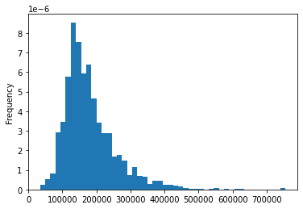
Dataset
We utilize the Ames Housing Dataset which describes a wide range of characteristics of in Ames, Iowa sold between 2006 and 2010
In total 79 Features(35 numerical and 44 categorical)
1 continuous label the final sale price
Train dataset contained 1460 houses
Test dataset contained 1459 houses with all features but the final sale price
Distribution of housing data by price

Slide 4
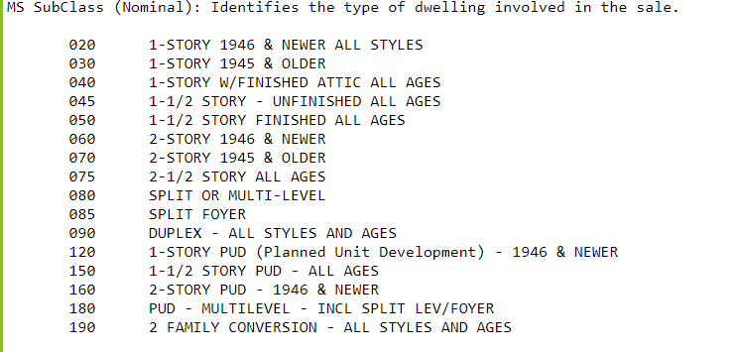
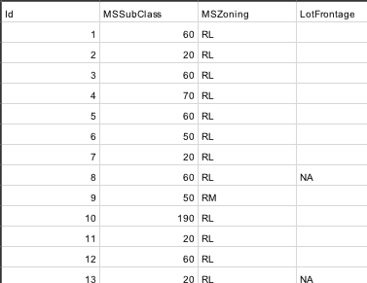
Data Cleaning
Filled nulls of these features with “None” dummy values:
Alley, FireplaceQu, PoolQC, Fence, MiscFeature, MasVnrType
Did something special for these features:
MSPUD (extracted from MSSubClass)
HasGarage and HasBasement
Condition1 + Condition2 (combined Condition dummies)
Exterior1 + Exterior2 (combined Exterior dummies)
MiscFeature/MiscValue (multiplied MiscFeature dummies by MiscValue)
Removed row from train set where Electrical was null
Dropped these features:
GarageYrBlt (too many nulls, covered by YearBuilt)
MSSubClass (covered by MSPUD as well as many other features)
MiscVal (covered by MiscFeature dummies)
MiscFeature_Elev (doesn’t appear in train set)
MiscFeature_TenC (doesn’t appear in train set)
Numerical Values were filled in by a simple median imputer
Remaining null categorical values were covered up with dummy encoding
Any features left that were in train but not test and vice versa were dropped, leaving a total of 259 features.
MSSubClass extract if PUD or not then drop the feature
Deleted GarageYrBlt Feature
For Alley, FireplaceQu, PoolQC, Fence, all basement and garage, MasVnrType/MasVnrArea features all nulls were replaced with the string ‘None’
Numerical nulls will be handled by simple median imputer
We then created dummies on all categorical data
Combined dummies for Condition1+Condition2 and Exterior1+Exterior2
We only deleted 1 row in train due to a null electrical column and none in test
The test dataset had additional features with nulls vs the train dataset, but were very small
Notes:
Alley,fireplace, pool, fence, misc feature- Filled all nulls with None
Basement, garage- separate categorical value for nulls
Numerical nulls handled by imputer
Alley
FireplaceQu
PoolQC
BsmtQual
GarageType
Fence
MiscFeature
MasVnrType/MasVnrArea
Electrical
GarageYrBlt
MSPUD
Condition1 + Condition2
Exterior1st + Exterior2nd
MiscFeature

Slide 5
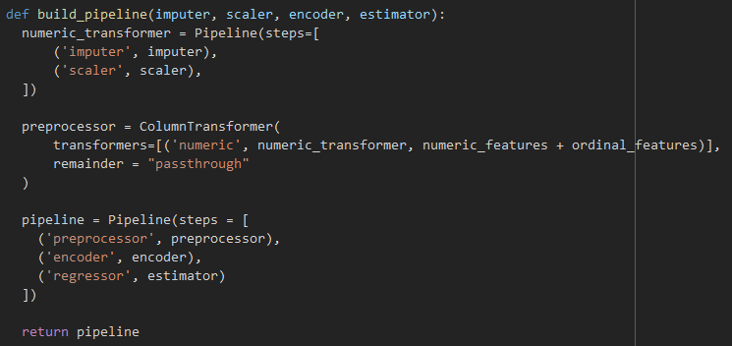
Pipeline
SimpleImputer for Numerical Features
Filled numerical nulls with the median value of the feature
Standard Scaler for Numerical Features
z = (x - u) / s where u is the mean and s is the standard deviation
SelectKBest and PCA for feature reduction
Found 150 features to be around the right value
SelectKBest uses mutual_info_regression to score features
Looked at 5 Estimators (on next slide)

Slide 6
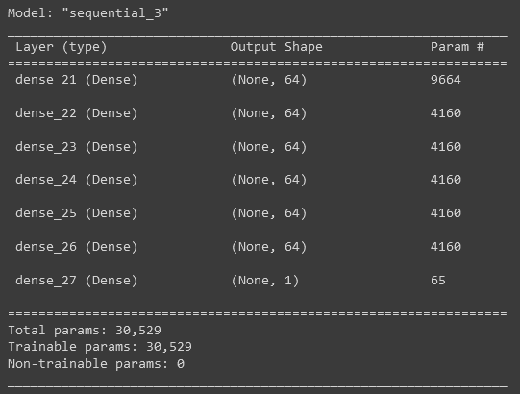
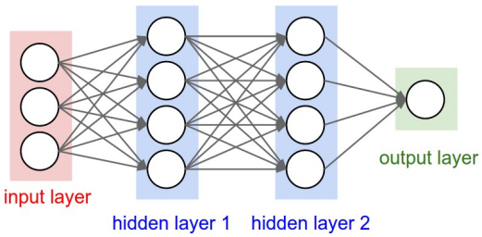
Estimators/Models
Linear Regression with Regularization
LassoCV - L1
10000 iterations
ElasticNetCV - Mixed between L1 and L2
L1 ratios: [0.1, 0.5, 0.7, .91, .95, .97, .99, .995, .999]
10000 iterations
RidgeCV - L2
Alphas [0.1, 1 to 99]
Neural Networks
Chosen to try and get better fit for non-linear patterns in data
MLPRegressor from scikit-learn
Loss Function - Mean Squared Error
64 nodes per layer, 5 hidden layers, learning rate 0.05, max iterations 1000
Self-made Feed Forward Neural Network with Keras
Loss function - mean_squared_logarithmic_error
Experimented with lots of different nodes per layer, different number of layers, and learning rate
Tried dropout layers made model perform worse
Best model 64 nodes for 6 hidden layers, dropout 0, learning rate .3, 100 epochs, Hidden layer activations all relu
Output layer single node relu activation
Input size of 150

Slide 7

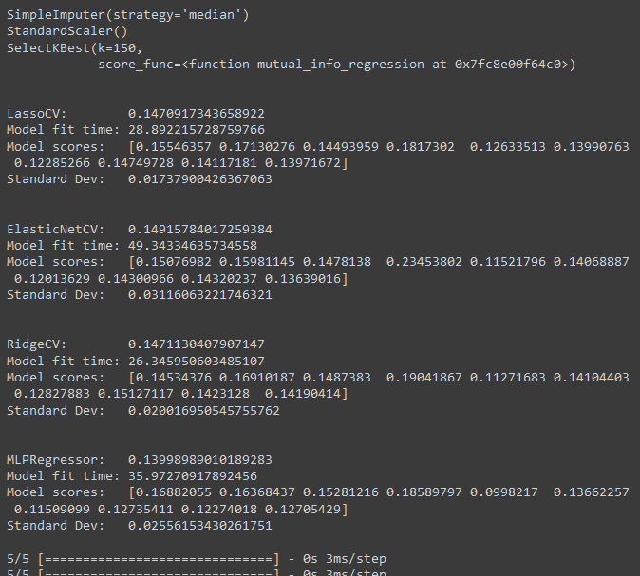
Scoring
Used 10-Fold Cross Validation to compare models and tune hyperparameters
Took the RMSE of the logs of the predicted and actual values
This makes errors at high sale prices more comparable to errors at low sale prices
Matches the scoring function used on Kaggle

Slide 8
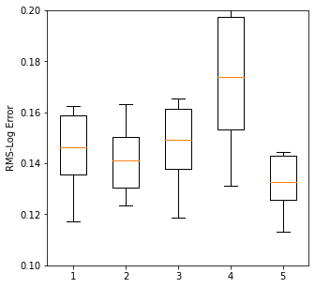
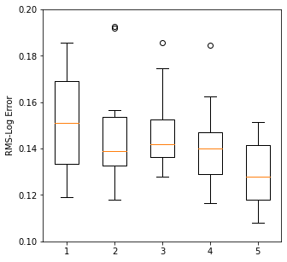
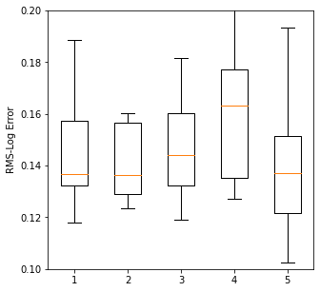
Model Performance and Results
673/4506 above average on Kaggle
No Feature Encoding
Select 150 Best
150 Feature PCA
Models
1. LassoCV
2. ElasticNetCV
3. RidgeCV
4. MLPRegressor
5. Keras FNN

Slide 9
Challenges and Conclusion
Input size changes for neural network due to multiple different methods of feature selection.
Test dataset had different null values from train dataset, we had to develop different dataset cleaning methods.
We achieved above average score on Kaggle (~0.125).
We could look at outliers and eliminate them to see if it would improve our results

Slide 10
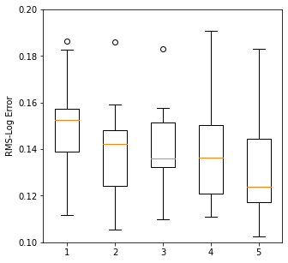
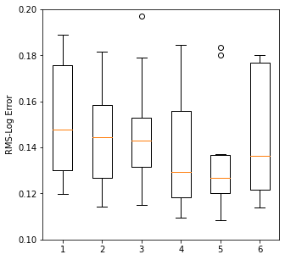
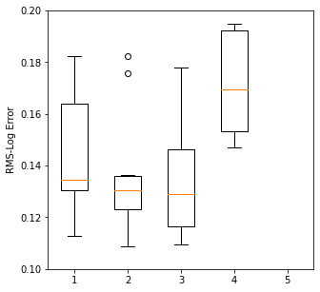
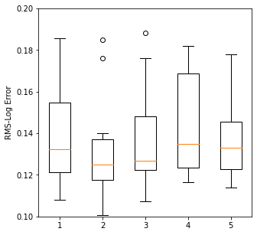
Model Results (Temp Slide)
Neural Networks with Select 150-Best and relu output
MLP with 6 layers, 0.3 learning
MLP with
MLP with
MLP with 5 layers, 0.05 learning
FNN with 6 layers, 0.3 learning
Regression Models with Select 150-Best
LassoCV
ElasticCV
RidgeCV
MLPRegressor
FNN with relu output
FNN with linear output
FNN with Select 150-Best and relu output
FNN with 9 layers
FNN with 7 layers
FNN with 5 layers
FNN with 3 layers
FNN with 1 layer
FNN with Select 150-Best and relu output
FNN with 7 layers
FNN with 6 layers
FNN with 5 layers
FNN with 4 layers
FNN with 3 layers

